Slide 1
Framework - Generic Extracts and Data Governance Metrics
- Srikrishna Bingi
www.exusia.com

Slide 2
Framework - Generic Extracts and Data Governance Metrics
Generic Extracts:
  Extracts data from DGC basing on certain criteria.
  Generates a ‘Detailed’ file with asset information.
Governance Metrics:
  Consumes ‘Detailed’ file and computes aggregates depending on ‘keys’ specified.
  Output is a summary file with data governance metrics.

Slide 3


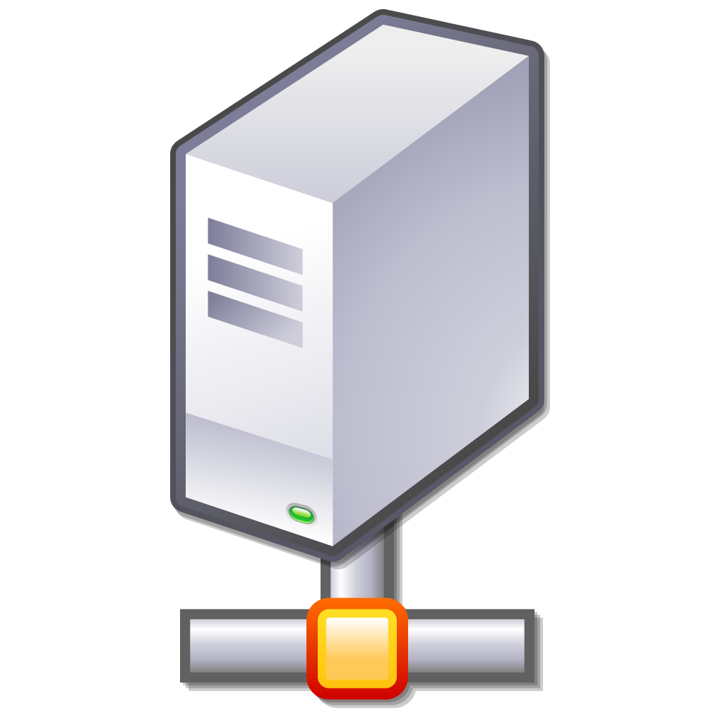

Framework - Generic Extracts and Data Governance Metrics
Generic Extracts:
  Using Collibra REST APIs, the extraction process fetches asset information from DGC.
  Filter conditions are specified in parameter file (yaml file).
  Output fields to be displayed can be specified in the parameter file.
Collibra DGC
Collibra Internal
Database
End User
1. REST API
2. Query to
Internal DB
4. JSON/XML Response
3. Response sent
To server

Slide 4
Framework - Generic Extracts and Data Governance Metrics
Data Governance Metrics:
  Classification of data governance metrics:
      Adoption Category – Describes number of assets by asset type, status, etc
      Completion Category – Helps in understanding which assets have all attributes and relations defined vs not defined.
      Process Category – Metrics related to Collibra workflows. Helps in answering questions such as “How many workflows are used by a specific business asset?”
      “What are the most commonly used workflows?”
      Activity Category- Helps in understanding most visited assets.
      Quality Category – Quality metrics using Data Quality rules.
      Issue Category – Metrics related to Issue Management.

Slide 5
Framework - Generic Extracts and Data Governance Metrics
Framework Execution Steps:
  Configure parameter file and place it in the corresponding directory
  Specify output folderpath for target files (parameterization yet to be implemented).
  Specify email if necessary (implementation done - integration pending).
  Execute ‘Main’ script with parameter file name as an input argument.

Slide 6
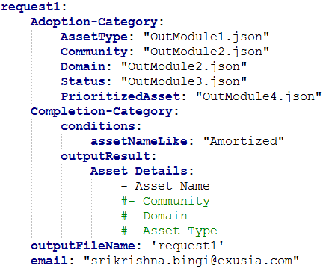

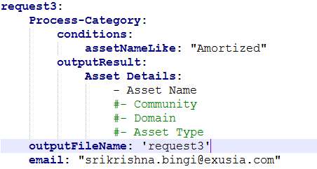
Framework - Generic Extracts and Data Governance Metrics
Parameter File Configuration:
  Specify metric category and filter conditions. Eg:

Slide 7
Framework - Generic Extracts and Data Governance Metrics
‘Detailed’ File Generation:
  Data is extracted from DGC using either of the two different approaches:
    Output Module - ‘/output’ endpoint REST API
    Non Output Module - REST APIs other than ‘/output’ endpoint
  Asset data fetched is stored in a ‘Detailed’ file.
  In case end user requests only an extract, the ‘Detailed’ file can be shared.

Slide 8
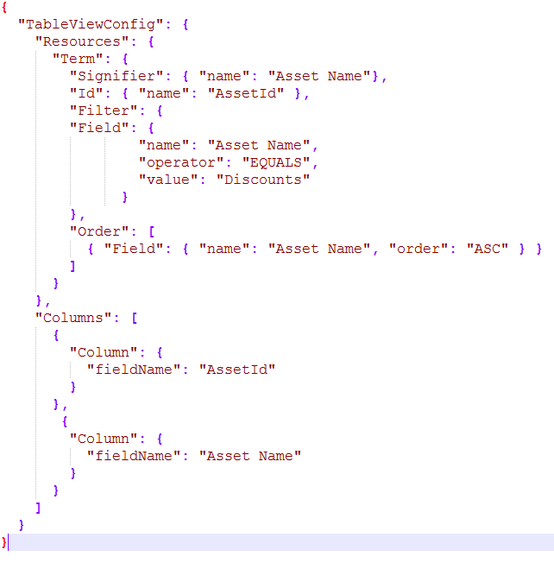

Framework - Generic Extracts and Data Governance Metrics
‘Detailed’ File Generation – Using ‘Output’ module:
  Reference Link – ‘Output’ Module

Slide 9
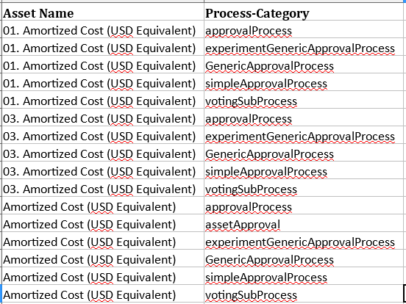
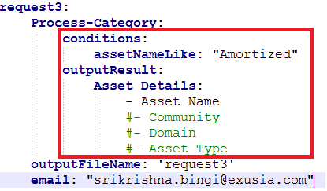
Framework - Generic Extracts and Data Governance Metrics
‘Detailed’ File Generation – Without using ‘Output’ module:
  Specify two criteria:
    Conditions – to filter out required assets. Ex: AssetNameLike: “Amortized Cost”
    OutputResult - Asset information that need to be displayed. Ex: “Asset Name”, “Community”..

Slide 10
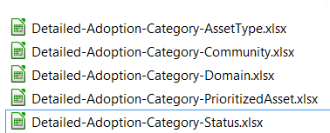
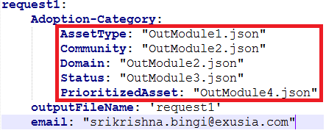

Framework - Generic Extracts and Data Governance Metrics
Data Governance Metrics Generation – ‘Adoption’ Category
  Uses ‘Output’ module to fetch the ‘Detailed’ information.
  Input ‘JSON’ file would have all the group by columns.
  In case of multiple group by columns, column at lowest level of granularity is specified as ‘key’ shown below

Slide 11
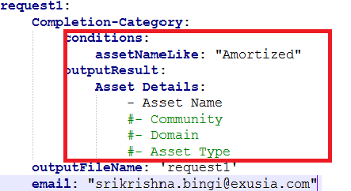

Framework - Generic Extracts and Data Governance Metrics
Data Governance Metrics Generation – ‘Completion’ Category
  Uses non - ‘Output’ module approach to fetch the ‘Detailed’ information.
  Requires ‘Conditions’ and ‘OutputResult’ sections.

Slide 12


Framework - Generic Extracts and Data Governance Metrics
Data Governance Metrics Generation – ‘Activity’ Category
  Uses non - ‘Output’ module approach to fetch the ‘Detailed’ information.
  Fetches last viewed assets per timespan mentioned w.r.t current time.

Slide 13
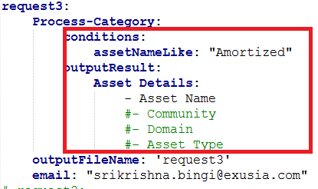
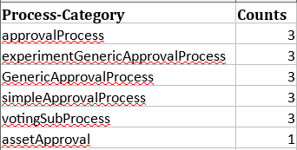
Framework - Generic Extracts and Data Governance Metrics
Data Governance Metrics Generation – ‘Process’ Category
  Uses non - ‘Output’ module approach to fetch the ‘Detailed’ information.
  Requires ‘Conditions’ and ‘OutputResult’ sections.

Slide 14
The End
- Srikrishna Bingi
www.exusia.com

